Slide 1
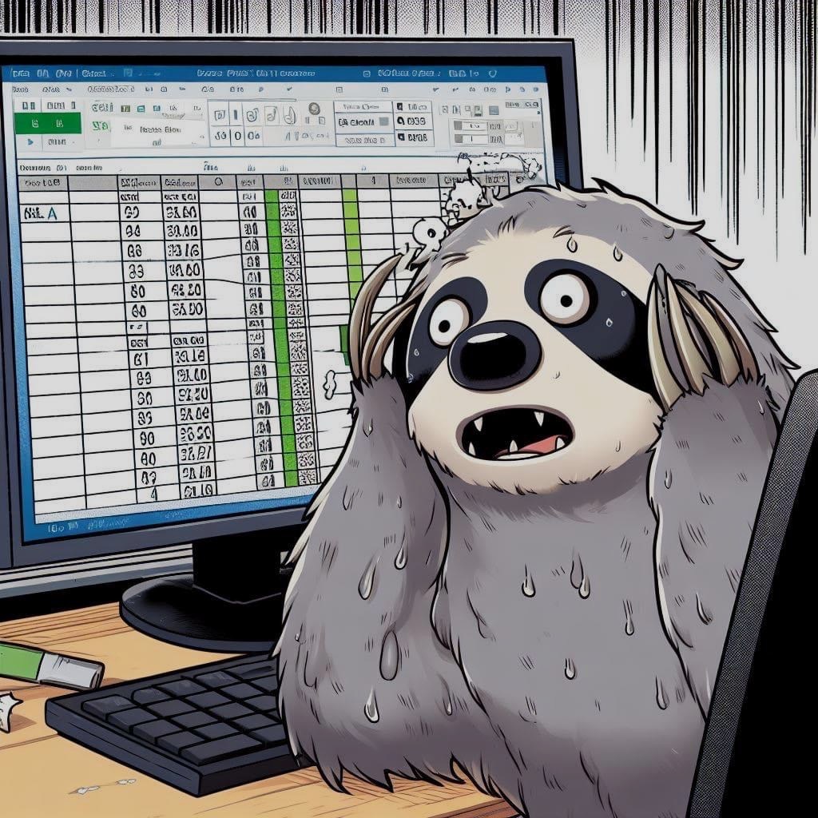
DSi 03 : Project 2
House Price Predict
Problem : What will affect the price of the property in the future?

Slide 2
Process
Test Model
Gether Data
Train Model
EDA - Cleaning
EDA - Analyze Data

Slide 3
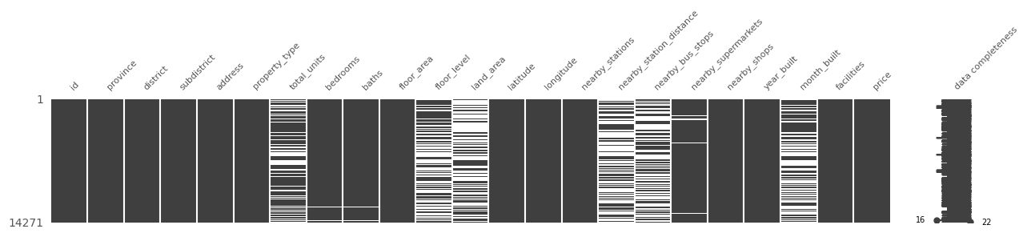
EDA - Cleaning
Data Train & Test is same process

Slide 4
EDA - Cleaning [Clean Null and 0 values]
Replace: With Mean by group of “property_type”
data_train['total_units'].fillna(data_train.groupby(["property_type"])["total_units"].transform('mean'), inplace = True)
data_test['total_units'].fillna(data_test.group
Replace: by using KNN Imputer
from sklearn.impute import KNNImputer
imputer = KNNImputer(n_neighbors=5)
data_train['imputed_column'] = imputer.fit_transform(data_train[['total_units']])
data_test['imputed_column'] = imputer.fit_transform(data_test[['total_units']])

Slide 5
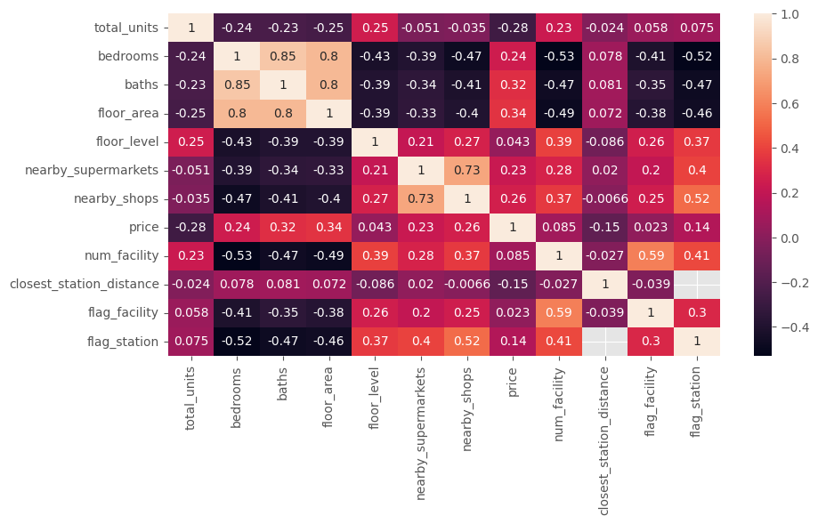
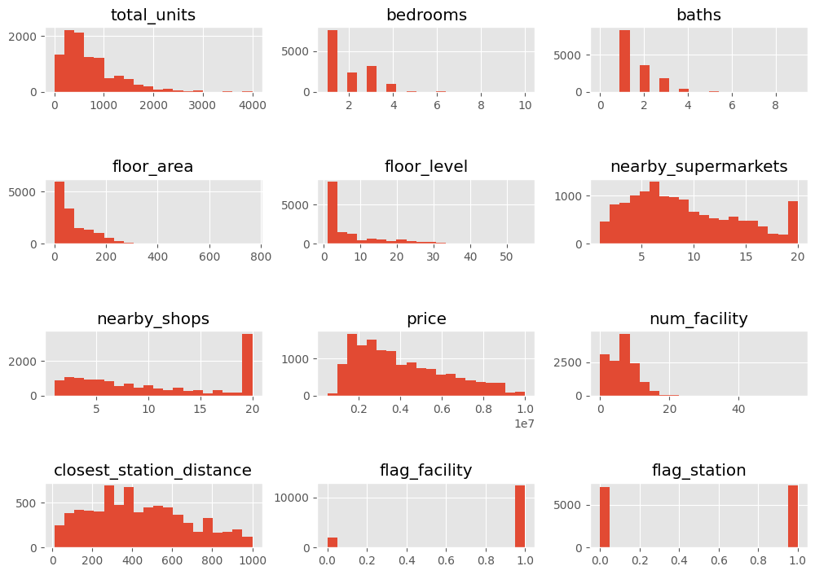
EDA - Analyze
Correlation Heatmap diagram
Histogram
Result : low correlation and distribute is not normal

Slide 6
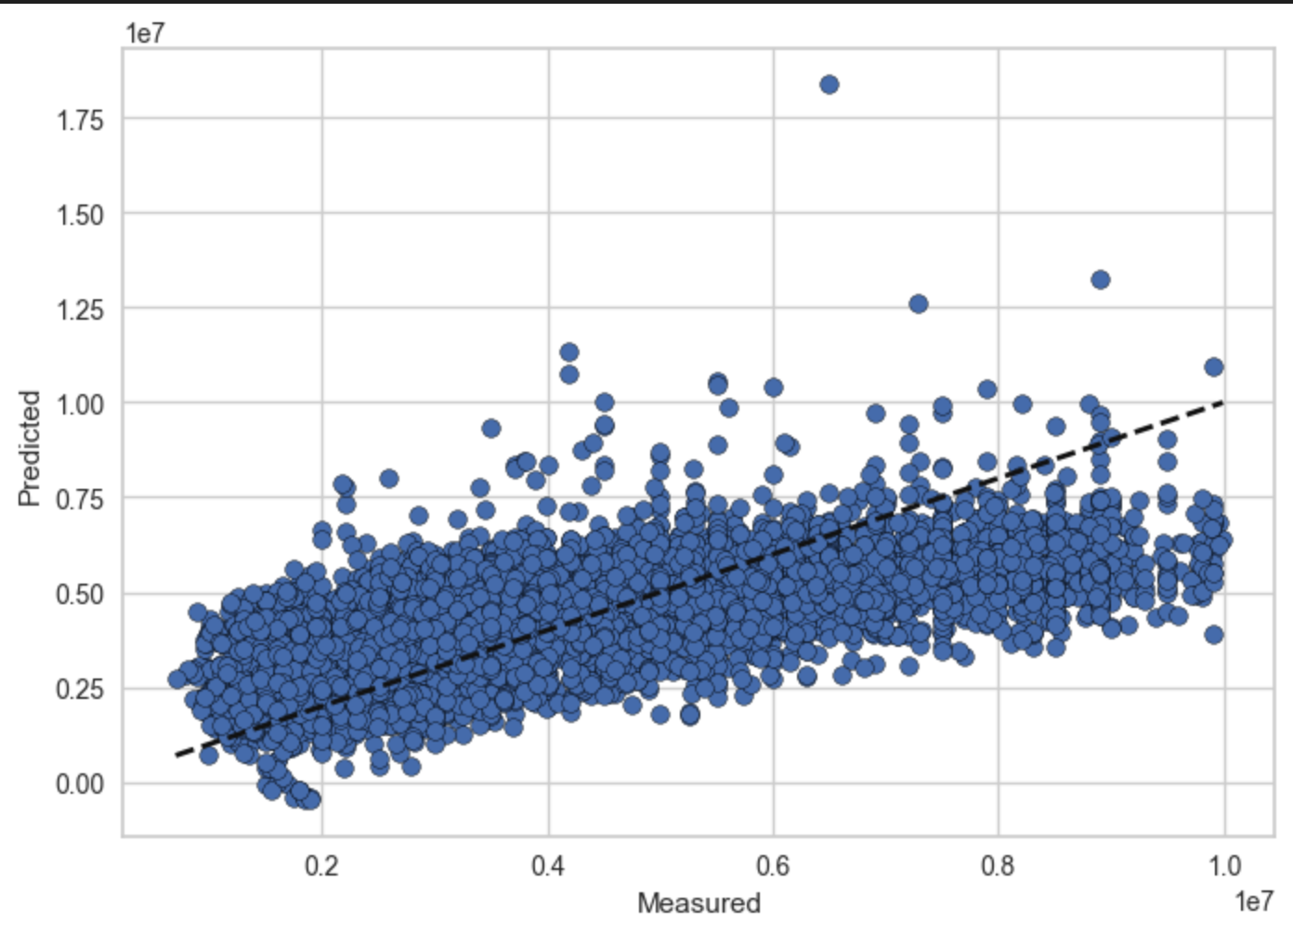
Sample 1 : Predicted House price by using number of facility
Model | Score
Linear Regression | Mean absolute error: 1,629,248.658 Mean squared error: 3984652508232.579 R2-score: 0.163
Linear Regression (with scaling) | Accuracy: 0.152 (+/- 0.059)
Cross Validation with scaler | Accuracy: 0.156 (+/- 0.066)
Ridge | Mean absolute error: 1,629,252.429 Mean squared error: 3984646490785.181 R2-score: 0.162953
Ridge with Scaling | Mean absolute error: 1,629,264.591 Mean squared error: 3984662560457.218 R2-score: 0.162949
Lasso | Mean absolute error: 1,629,248.777 Mean squared error: 3984652473447.417 R2-score: 0.162952

Slide 7
Sample 1 : Conclusion
To predict House price by using number of facility in data set, Model 1 Linear Regression give R-Square higher than another model . However the value 0.163 is considered a very small value, which cannot be used.
May conclude that This information may not be suitable for Linear Regression. Should consider using more feature to predict

Slide 8
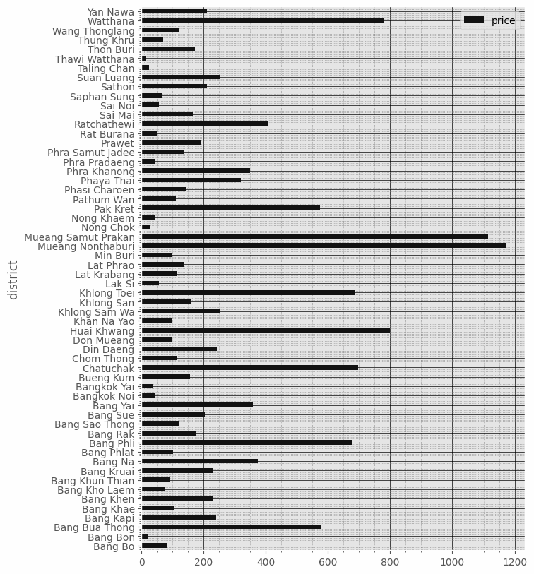
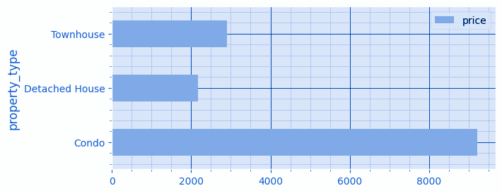
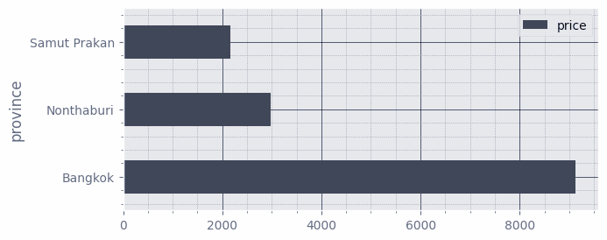
Sample 2 : Predicted House price by geography
Based on the data, it can be seen that there is still the same data deviation as sample 1.

Slide 9
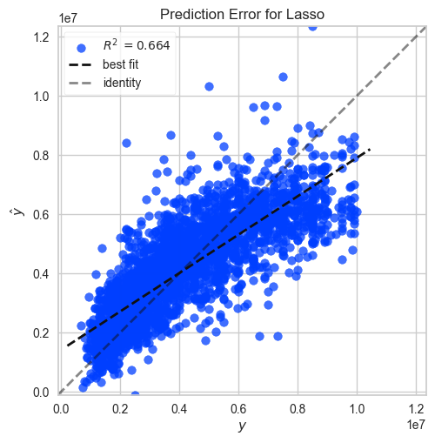
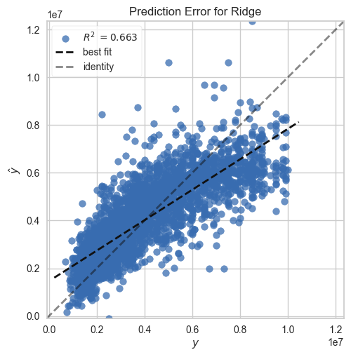
Sample 2 : Predicted House price by geography
Model: Lasso
Model: Ridge
R2-score: 0.664
R2-score: 0.663

Slide 10
Sample 2 : Conclusion
Recommend:
If you are a buyer or seller. The area of the property should be considered as the first thing. The facilities obtained from the project are secondary considerations.
Next:
A group of facilities so that they can be processed even better.
In based on data that is the area and type of accommodation, Model Lasso and Ridge give a similar output of 0.664 - 0.663. It is therefore concluded that the location of the accommodation affects the valuation.

